Slide 1
QUT Uninhabited Aerial Systems
Objective: to develop a fully cooperative UAS with onboard sense-and act capabilities.

Slide 2
QUT UAS Team
Luis Mejias
Science leader
Supervising Controller
Scott McNamara
UAV/payload controller
Rhys Mudford
Supervising/payload controller
Richard Glassock
Launch Controller
Brenden Menkens
Engineer
Nicholas Rutherford
Engineer
Task:
Advanced Flight Termination System for UAS
Task:
Predictive Flight Management System for UAS

Slide 3
Predictive Flight Management System Nicholas Rutherford

Slide 4
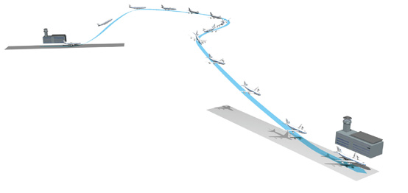
Presentation Contents
Predictive Flight Management System Concept (PFMS)
Systems Engineering Practices
High Level Objectives
Work Breakdown
Schedule
Project Risks and Budget
System Architecture
PFMS Models
Three Degree of Freedom Model
Six Degree of Freedom Model
System Validation
Project Status
Conclusion

Slide 5
PFMS Concept
Concept
Determines when and whether the UAS will intercept a waypoint in a defined time.
Identifies invalid waypoints sent by the traffic controller due to communication latency.
Current QUT systems
Use displacement and velocity to predict arrival times.
Ignore the dynamics of the aircraft, weather effects and the effect of successive waypoints on a flight trajectory.

Slide 6
Project High Level Objectives
HLO-1 - Mandatory
Conduct a literature review on FMS, control and aircraft dynamics
HLO-2 - Mandatory
Develop a 2D & 3D PFMS simulation
HLO-3 - Desired
Install and validate the PFMS capability onboard a UAV
HLO-4 - Desired
Design an advanced PFMS capability and install and validate on a UAV

Slide 7

Work Breakdown Structure

Slide 8
Project Schedule
Schedule developed from work packages.

Slide 9
Project Budget & Risks
Project Budget
No incurred costs for software development.
Future Costs will be covered by the QUAS project.
Project Risks
Risk Management Plan.
Single Working Engineer.
Possible complex control methods and high level of coding proficiency.

Slide 10
System Architecture of PFMS

Slide 11
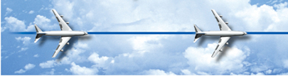
3 DOF Vehicle Dynamics Model
Matlab used for implementation.
Lacking multiple waypoint considerations.
2D prediction model with Rate of Turn Constraints at cruise velocity.
3D prediction model with Rate of Turn and Climb constraints at cruise velocity.

Slide 12
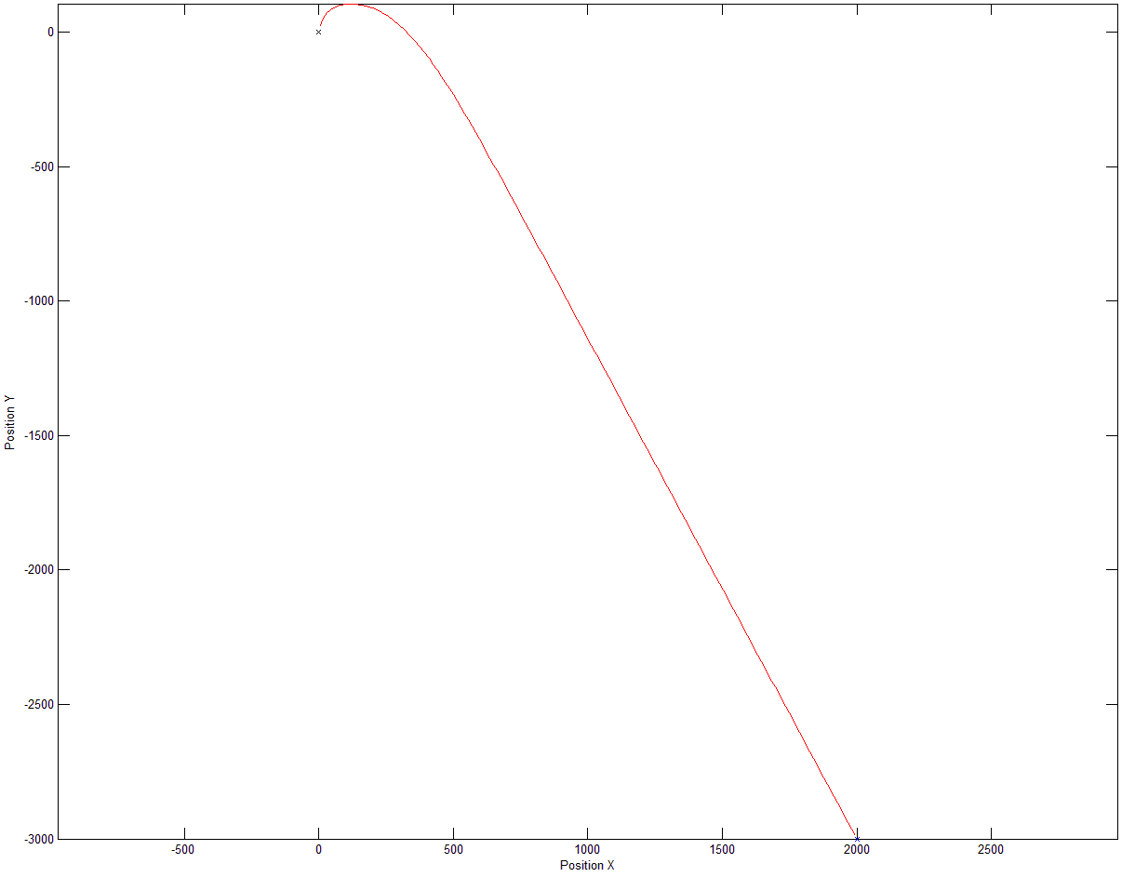
2D Trajectory

Slide 13
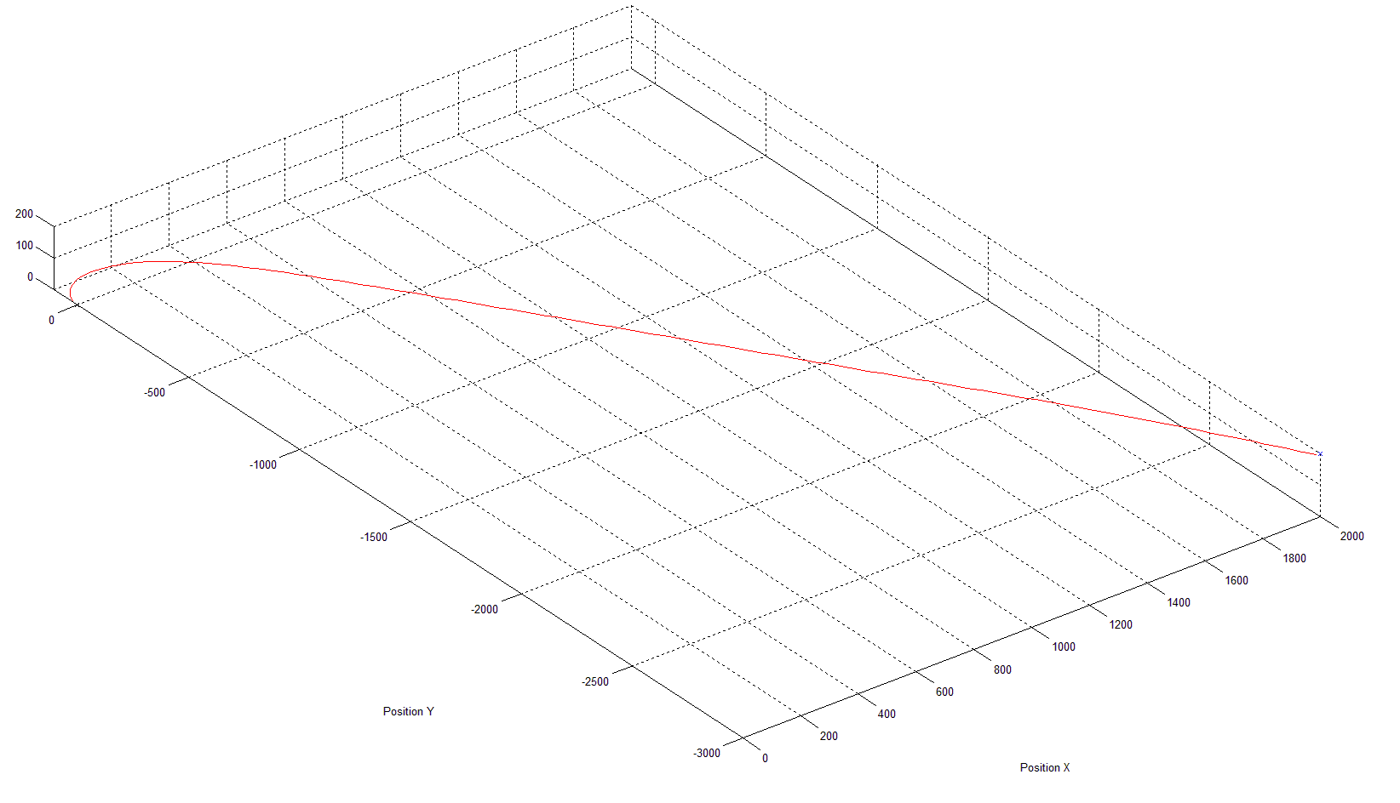
3D Trajectory

Slide 14
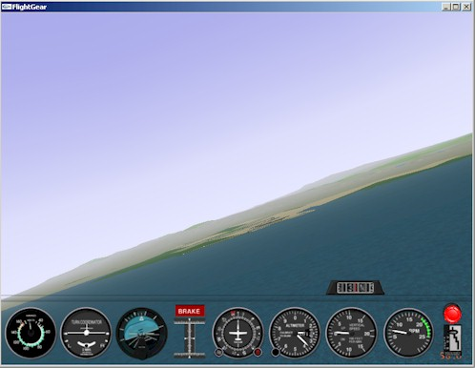
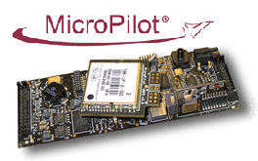
6 DOF Vehicle Dynamics Model
Based around a MicroPilot Autopilot.
Matlab Simulink and Aerosim Blockset.
Capable of prediction of a UAS in with waypoint navigation and attitude considerations.
Model visualisation using Flight Gear
Aerosim uses JSBSim, a open source C++ model.
FlightGear Flight Simulation

Slide 15
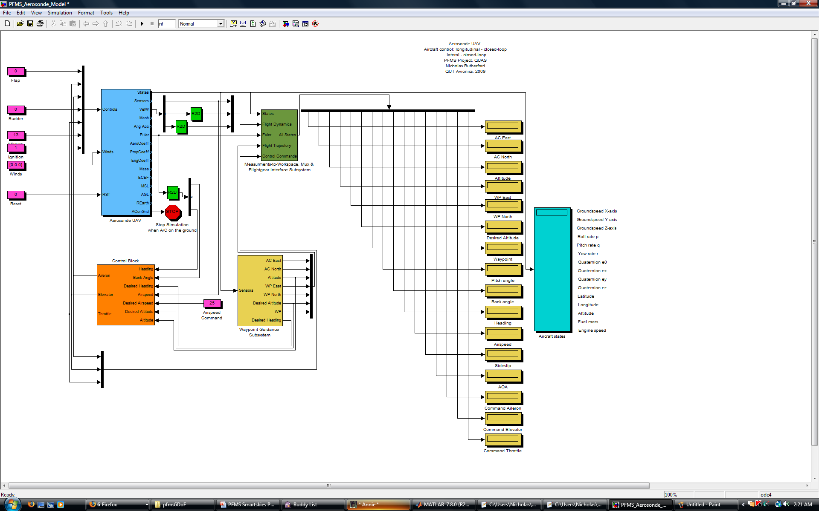
Simulink Implementation

Slide 16
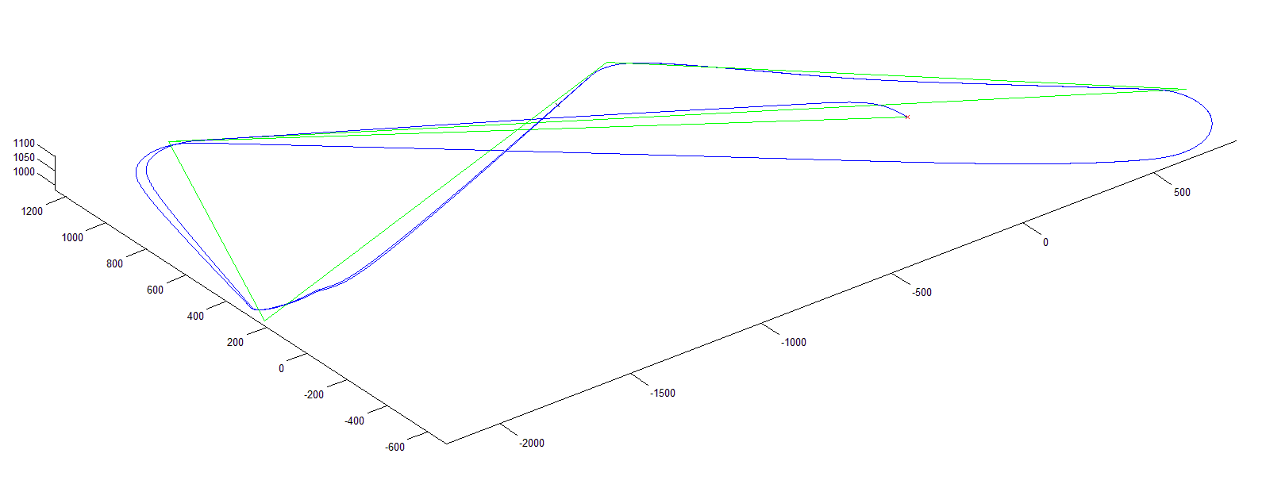
Flight Trajectory

Slide 17
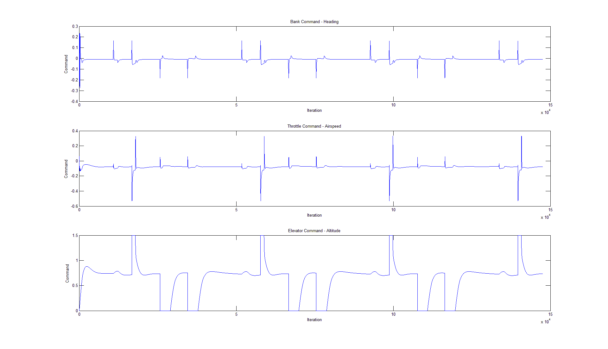
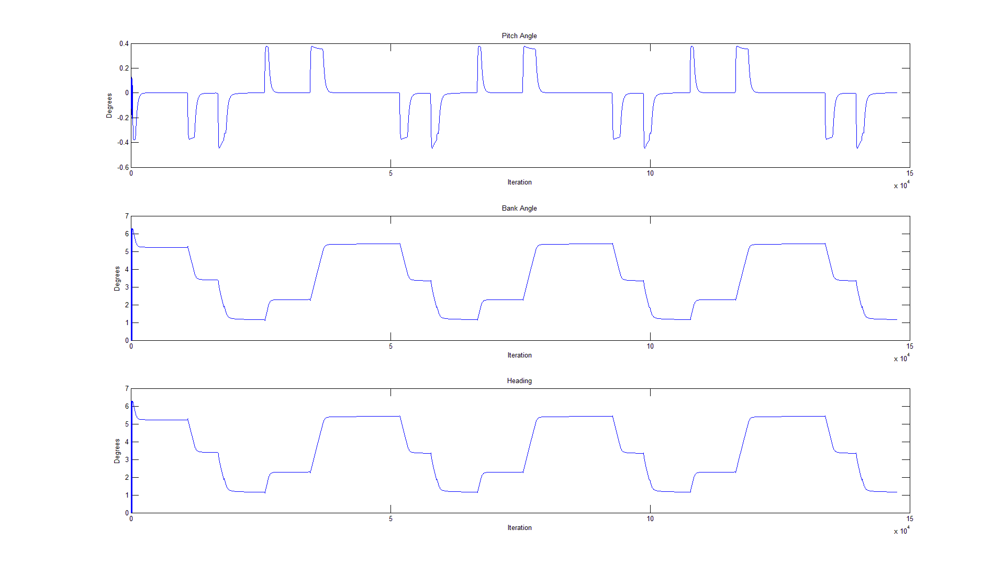
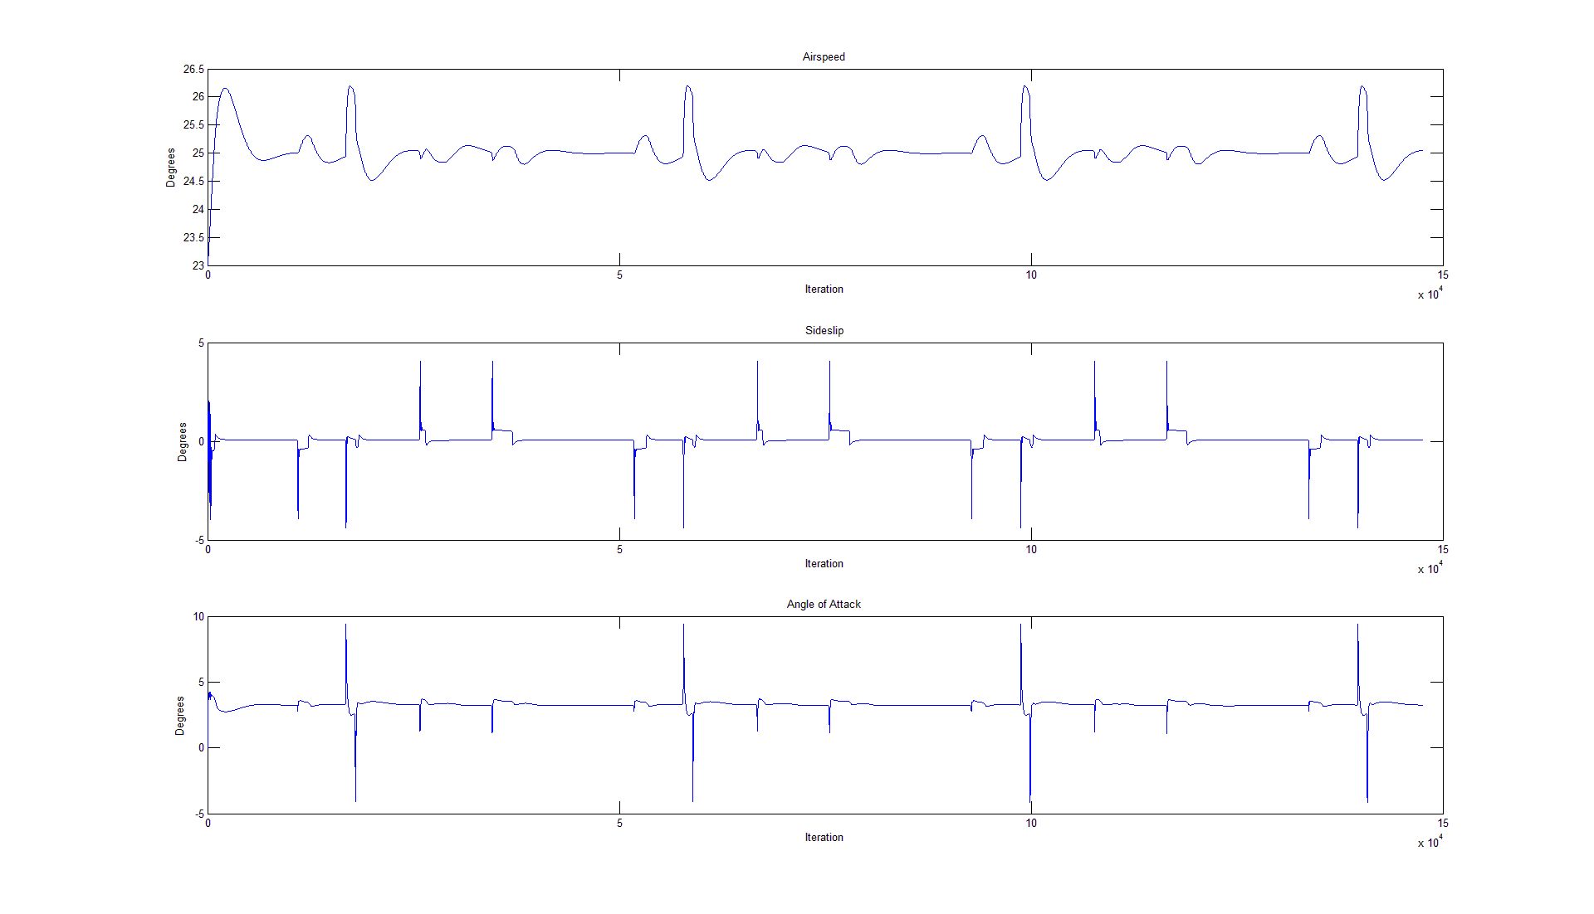
System Logs
Control Inputs
Euler Angles
Flight Dynamics

Slide 18
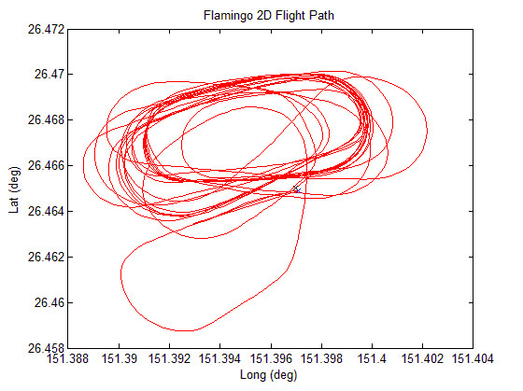
System Validation
Not official testing conditions.
Future controlled tests already planned.
Capture and compare standard telemetry.

Slide 19
Project Status
Current Progress
HLO-1: Literature survey completed.
HLO-2: Development of a 2D and 3D PFMS model capable of predicting the location of the UAS in a finite horizon.
Model still requires validation using telemetry.
Future
Validation using standard telemetry and subsequent system optimisation.
Implementation onboard a UAS in C++.
Introduction of advanced concepts.

Slide 20
Conclusions
Predictive Flight Management System Concept
Systems Engineering Practices
High Level Objectives
Work Breakdown
Schedule
Project Risks and Budget
System Architecture
PFMS Models
Three Degree of Freedom Model
Six Degree of Freedom Model
System Validation
Project Status
Conclusion

